Slide 1

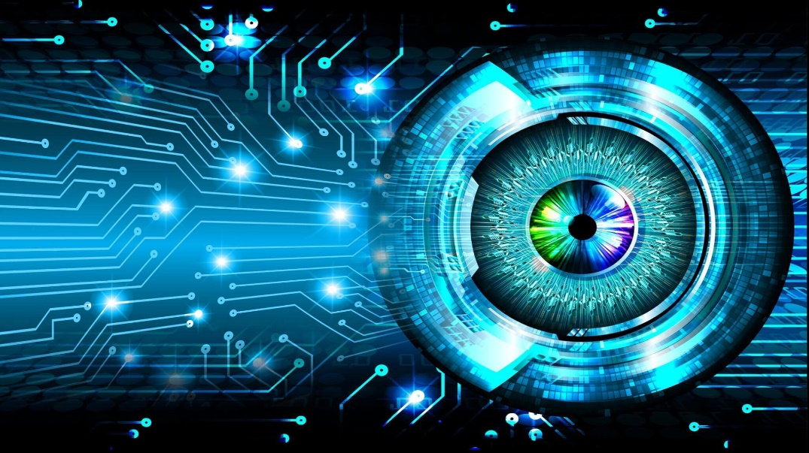
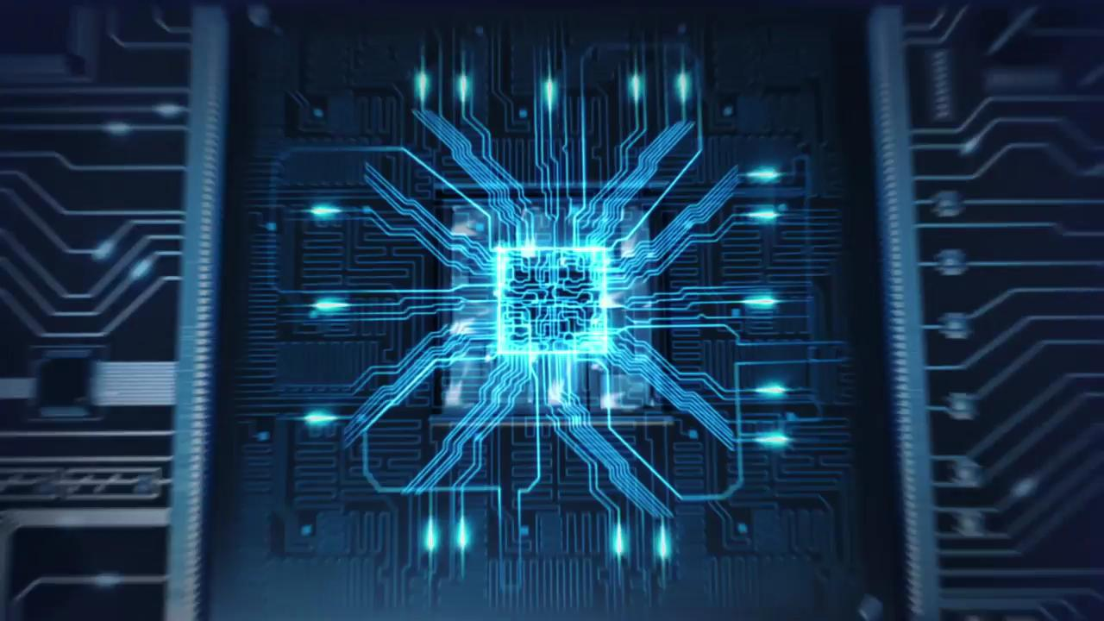
COMPUTER VISION & MACHINE LEARNING
- ASHWIN PHADKE

Slide 2
What Is Computer Vision?
Image analysis.
Scene Analysis.
Image Understanding.
Processing acquired data.
Data Segmentation and Representation

Slide 3
Who’s better?
The ages old :
HUMAN VS COMPUTER

Slide 4
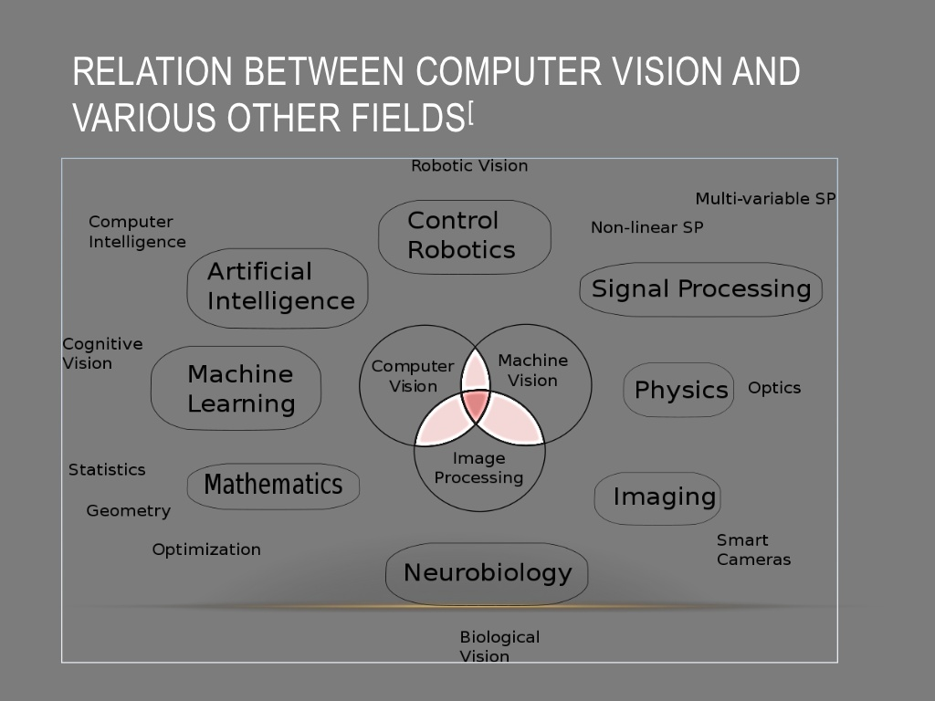

Slide 5
What we do
Image Acquisition.
Image Processing
Image Feature Extraction.
Image Data Detection, Recognition and Segmentation .
Interpretation.

Slide 6
How we do it
Shape
Texture
Background – Foreground.
Color
HSV – Hue , Saturation , Intensity.
RGB - red , Green Blue
LAB – Light , Green to Magenta, Blue to Yello

Slide 7
Do we really see such range of data?

Slide 8
Where’s the Mathematics they keep talking about?
Linear algebra
Probability and Statistics
Calculus
Signal Processing
Projective geometry

Slide 9
Applications?

Slide 10
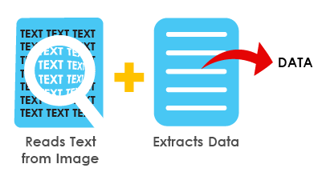
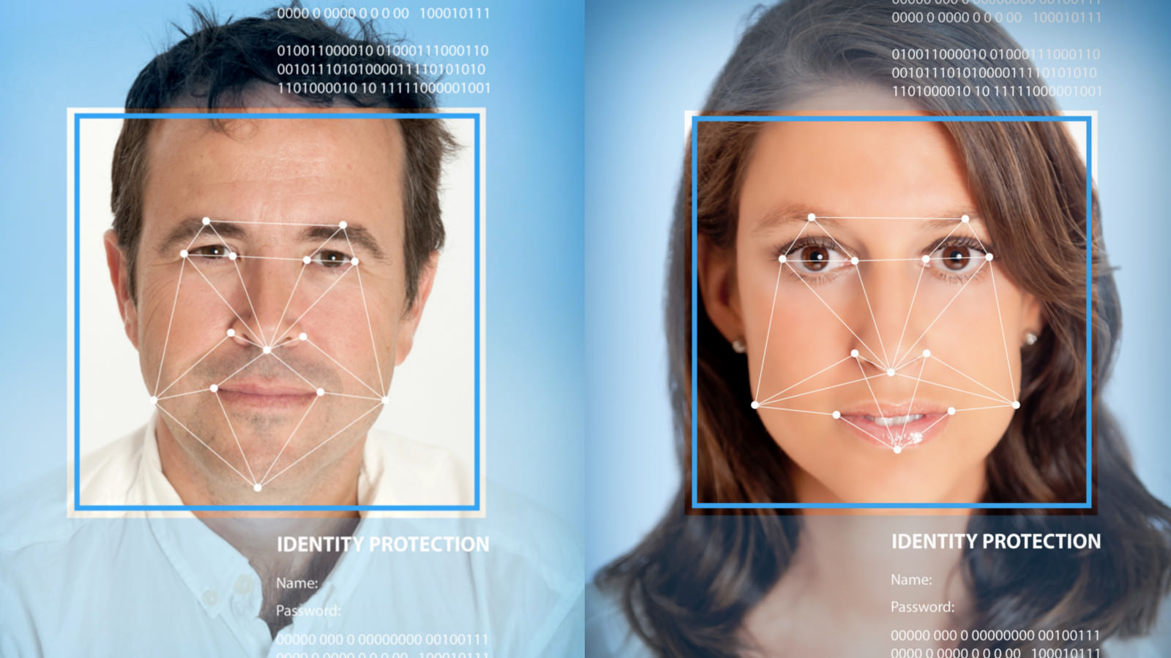
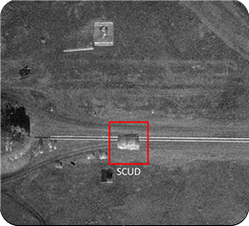
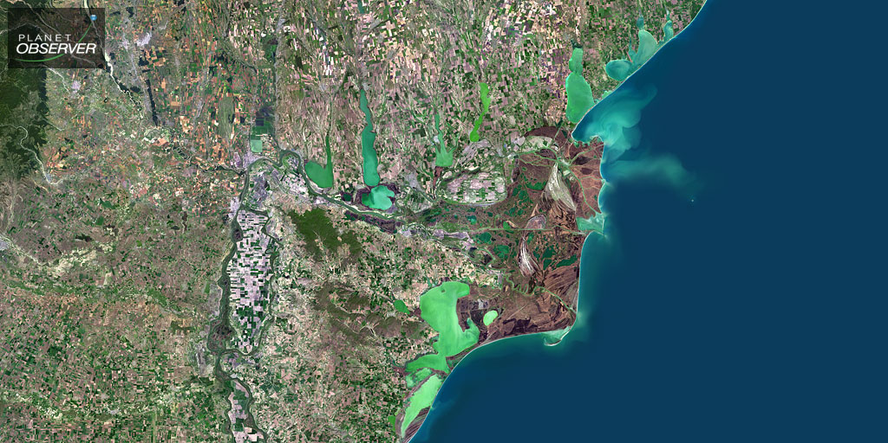

Slide 11
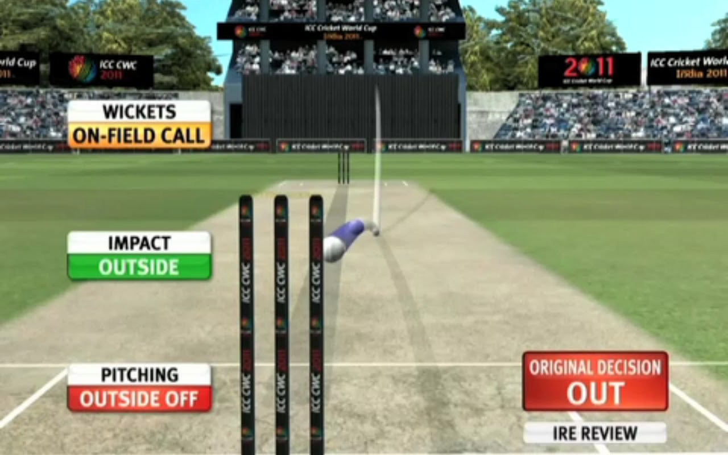

Slide 12
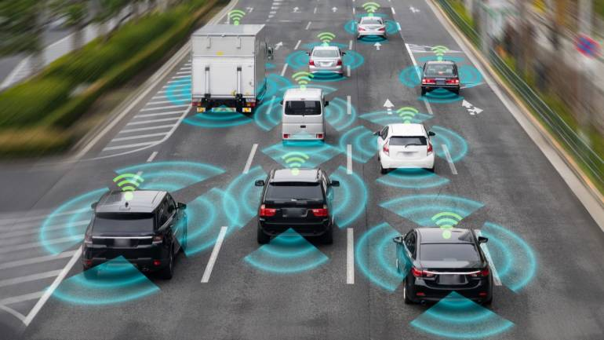
Smart car Domain

Slide 13
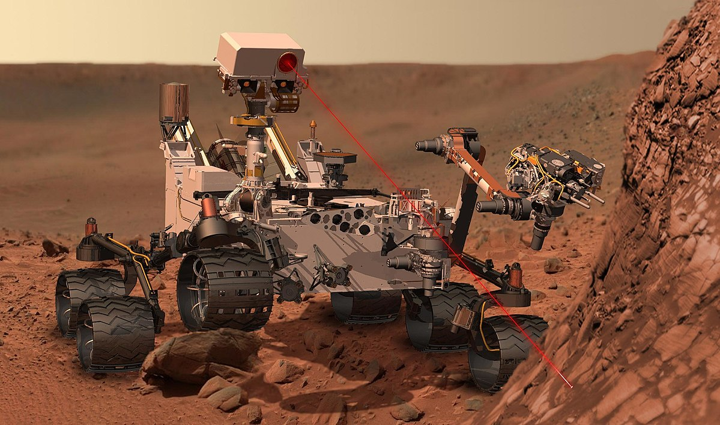
Rovers, robots, bots

Slide 14
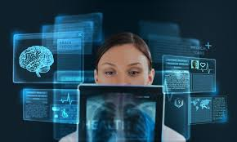
Medical Imaging

Slide 15

OpenCV

Slide 16
Recognition problems ?
What is it?
Object and scene recognition
Who is it?
Identity recognition
Where is it?
Object detection
What are they doing?
Activities
All of these are classification problems
Choose one class from a list of possible candidates

Slide 17
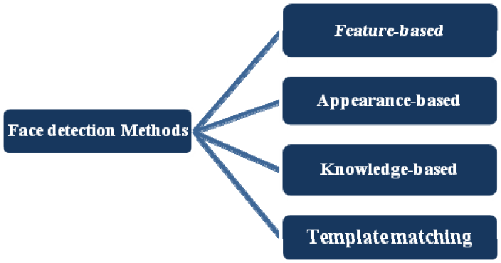

Slide 18
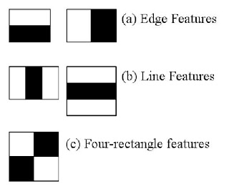
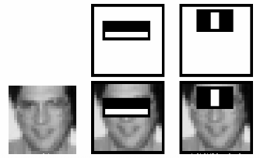
Haar features

Slide 19
Viola – Jones Algorithm
Haar
Integral features
Adaboost
Cascading

Slide 20
Let’s get coding

Slide 21
What more?
Face Recognition.
Emotion Recognition.
Behavior Detection.
Object Classification.
Object Detection.
LPR and Speed Detection and Estimation.
Medical analysis
QA

Slide 22

Reach me on :
Website : https://ashwin-phadke.github.io
Contact : 9860386639
Email : ashwinphadke1@gmail.com
Telegram : @AshwinPhadke

